Slide 1
Customer Segmentation using RFM Analysis and Clustering
CAPSTONE PROJECT
Presented By:
Student Name – Srinibas Masanta
College Name – Dhirubhai Ambani University
Department – MSc Data Science

Slide 2
OUTLINE
Problem Statement
Project Objectives
Data Overview
RFM Framework
Data Pre-processing & Outlier Analysis
Customer Segmentation Approach
Core Customer Segments (Non-Outliers)
Outlier-Based Strategic Segments
Cluster Distribution & Summary Statistics
Business Insights & Recommendations
Conclusion & Future Scope
References & Project Resources

Slide 3
Problem Statement
.
Problem Overview
Retail businesses serve customers with widely varying purchasing behaviors
Treating all customers uniformly leads to:
Inefficient marketing spend
Missed revenue and retention opportunities
Transactional data exists, but:
It is unstructured
Does not directly translate into actionable customer segments
Key Challenge
How to transform raw transaction data into meaningful and actionable customer groups

Slide 4
Project Objectives
Objectives
Segment customers based on purchasing behavior
Identify:
High-value customers
At-risk customers
Growth-potential customers
Enable targeted business strategies such as retention, upselling, and loyalty programs
Balance cluster quality with business interpretability

Slide 5
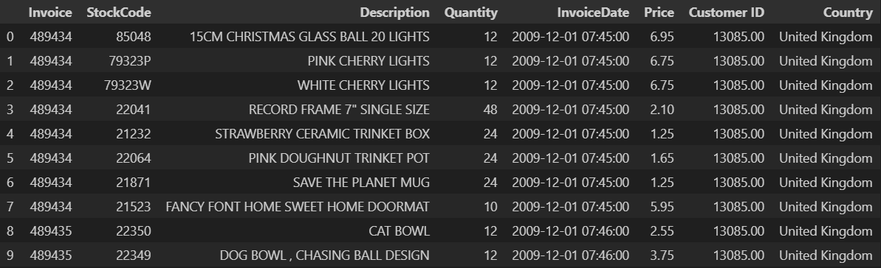
Data Overview
Dataset Summary
Retail transactional dataset
Key attributes:
Customer ID
Invoice Date
Quantity
Unit Price
Aggregated to customer level for analysis
Data Preparation
Cleaning and preprocessing performed
Approximately 23% of records removed due to inconsistencies and noise

Slide 6
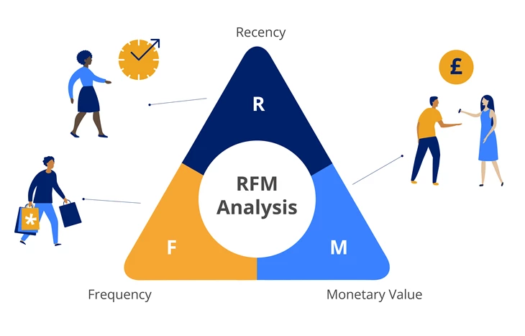
RFM Framework
RFM Metrics
Recency: Days since last purchase
Frequency: Number of transactions
Monetary Value: Total customer spend
Why RFM?
Captures customer engagement and value
Widely used in marketing analytics
Interpretable for business stakeholders

Slide 7
Data Pre-processing & Outlier Analysis
Data Preprocessing
Cleaned the raw transactional dataset by handling missing values, invalid entries, and inconsistencies
Aggregated transaction-level data to the customer level to compute Recency, Frequency, and Monetary (RFM) features
Removed records with insufficient or unreliable information, resulting in a cleaner and more consistent dataset
Standardized RFM features to ensure equal contribution during distance-based clustering
Outlier Analysis
Identified extreme values in Monetary and Frequency using statistical methods
Categorized outliers into:
Monetary-only outliers
Frequency-only outliers
Temporarily separated outliers before K-means clustering to prevent distortion of cluster centroids
Analyzed outliers independently as they often represent strategically important, high-impact customers

Slide 8
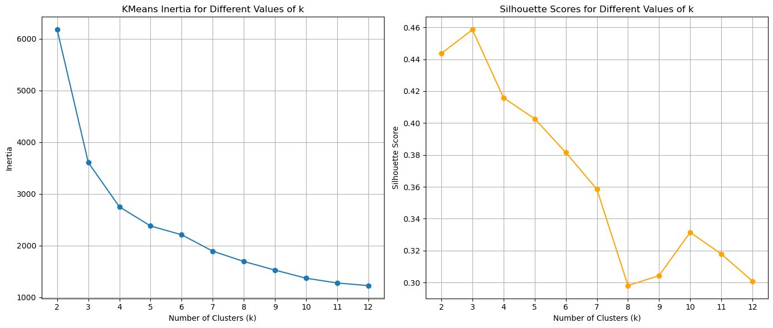
Customer Segmentation Approach
Clustering Strategy
K-means clustering applied to non-outlier customers
Number of clusters evaluated using:
Elbow method
Silhouette analysis
Cluster Selection
Silhouette score peaked at k = 3
k = 4 chosen as it:
Maintains strong separation
Improves business interpretability

Slide 9
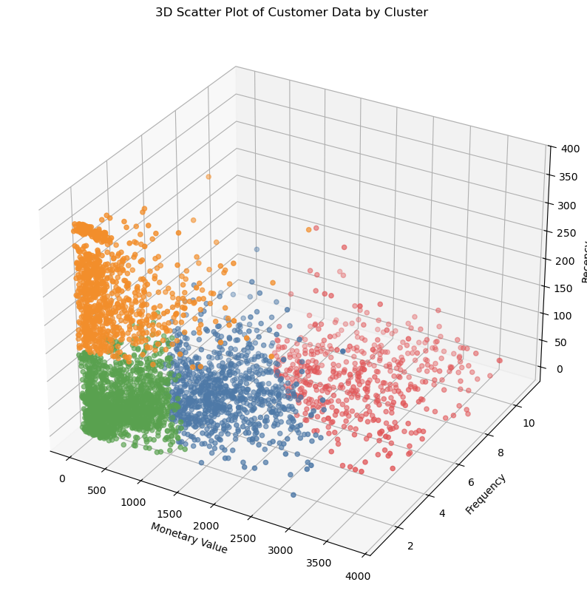
Core Customer Segments (Non-Outliers)
Identified Segments
RETAIN: Loyal and recent high-value customers
REWARD: High-value and frequent customers
NURTURE: Low frequency and moderate spenders
RE-ENGAGE: Inactive or at-risk customers
Interpretation
Each cluster reflects distinct purchasing behavior
Enables targeted marketing strategies

Slide 10
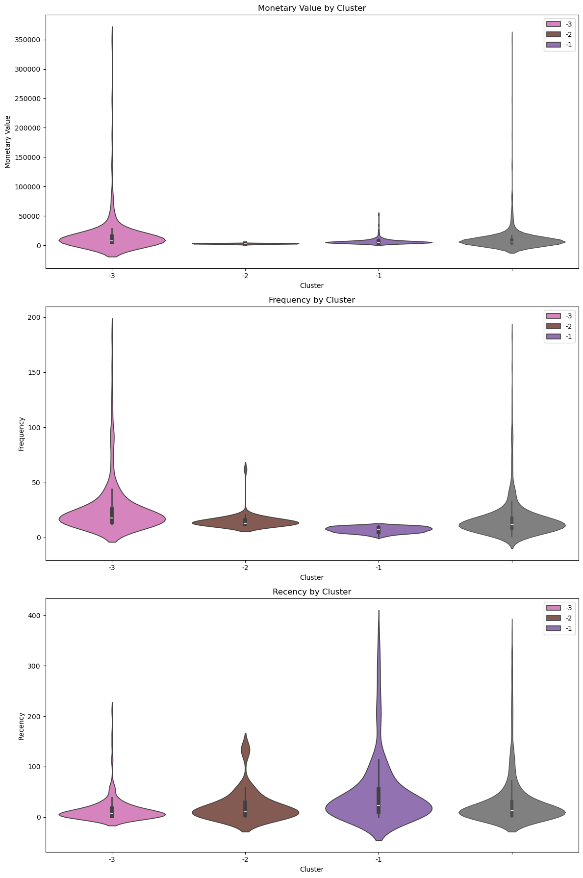
Outlier-Based Strategic Segments
Special Outlier Segments
PAMPER: High spend, low frequency
UPSELL: High frequency, low spend per transaction
DELIGHT: High frequency and high monetary value
Why Treat Separately?
These customers require personalized strategies
Small in number, high business impact

Slide 11
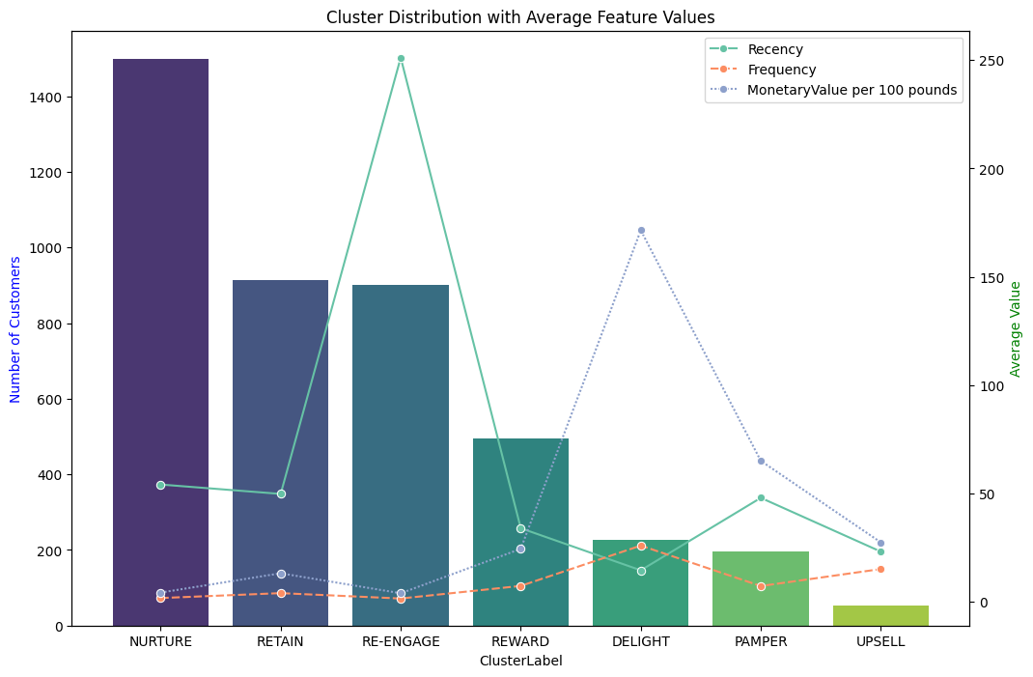
Cluster Distribution & Summary Statistics
Combined bar + line chart visualizes:
Customer count per cluster (bar)
Average Recency, Frequency, Monetary value (line)
NURTURE is the largest cluster, indicating many low-engagement customers
RE-ENGAGE shows high recency, reflecting inactive customers
RETAIN exhibits balanced RFM values
REWARD is smaller but shows higher frequency and spend
DELIGHT, PAMPER, UPSELL represent a small yet high-value customer base

Slide 12
Business Insights & Recommendations
Majority of customers fall into low to mid-engagement segments
A small proportion of customers drives disproportionate revenue
Different clusters require distinct business strategies, not a one-size-fits-all approach
Focus areas:
NURTURE: Gradual engagement and onboarding strategies
RE-ENGAGE: Targeted reactivation campaigns
RETAIN: Consistent engagement to maintain loyalty
REWARD / DELIGHT / PAMPER / UPSELL: Personalized offers and premium experiences

Slide 13
Conclusion & Future Scope
Conclusion
Successfully transformed transactional data into actionable segments
Combined clustering with outlier analysis for deeper insights
Delivered interpretable and business-ready segmentation
Future Scope
Customer Lifetime Value (CLV) modeling
Churn prediction
Dynamic segmentation over time
Integration with dashboards or CRM systems

Slide 14
References & Project Resources
References
Scikit-learn Documentation — K-means Clustering & Silhouette Analysis: https://scikit-learn.org/stable/auto_examples/cluster/plot_kmeans_silhouette_analysis.html
Academic references on RFM Analysis and Customer Segmentation: https://link.springer.com/article/10.1057/dbm.2012.17
Project Resources
GitHub Repository: https://github.com/srinibas-masanta/Customer-Segmentation-using-RFM-Analysis-and-Clustering.git
Online Retail II Dataset — UCI Machine Learning Repository: https://archive.ics.uci.edu/dataset/502/online+retail+ii

Slide 15
THANK YOU

